Slide 1
The Hope: Overcoming drug and alcohol addiction using Chatbot
CHATBOT PROJECT
Presented By:
Student Name- Kumari Shivyanshi Name- Masters Of Computer Application (MCA)

Slide 2
OUTLINE
Problem Statement (Should not include solution)
Proposed System/Solution
System Development Approach (Technology Used)
Algorithm & Deployment
Result
Conclusion
Future Scope
References

Slide 3
Problem Statement
"The Hope chatbot aims to address the pressing issue of drug and alcohol addiction by providing an accessible and personalized virtual support system. The Hope chatbot addresses this problem by offering a targeted intervention platform for individuals seeking to overcome drug addiction. The problem at hand involves the lack of easily available, individualized assistance for individuals seeking to overcome addiction, leading to higher rates of relapse and limited support networks. The Hope chatbot seeks to bridge this gap by offering a comprehensive and empathetic platform that tailors interventions, resources, and encouragement to the unique needs of users, fostering a supportive environment for sustained recovery.“

Slide 4
Proposed Solution
The proposed system for the chatbot designed to help individuals overcome drug and alcohol addiction, such as The Hope chatbot, could include the following key features and components:
User Assessment:: Implement a comprehensive initial assessment to understand the user's specific addiction history, severity, and individual needs.
Personalized Intervention: Develop an adaptive system that tailors interventions based on the user's profile and progress..
Progress Tracking: Implement a system to track and analyze the user's progress over time.Set milestones and celebrate achievements to motivate and reinforce positive behavior.
Real-time Support: Include a real-time chat feature for immediate support during moments of crisis or vulnerability.
Community Support: Facilitate connections with a supportive community where users can share experiences, advice, and encouragement.
Emergency Response: Implement protocols for handling emergency situations, including contact information for crisis hotlines and local emergency services.
User Privacy and Confidentiality: Ensure robust security measures to protect user data and maintain confidentiality, complying with relevant privacy regulations.
Integration with External Resources: Provide links and information about external resources such as rehabilitation centers, support groups, and counseling services.

Slide 5
System Approach
System requirements:
Hardware Requirements:
Multicore processor
Sufficient RAM (at least 8GB)
Adequate storage space for codebase, databases, and any other project-related assets.
A stable internet connection
Software Requirements:
Operating System(Windows 10 and above)
IBM Cloud Account
Integrated development environment (IDE) such as Visual Studio Code or Eclipse for streamlined coding.

Slide 6
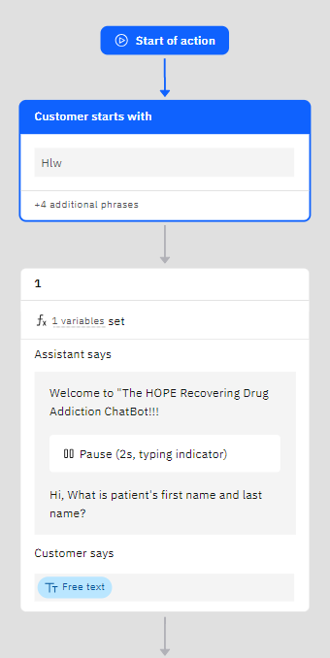
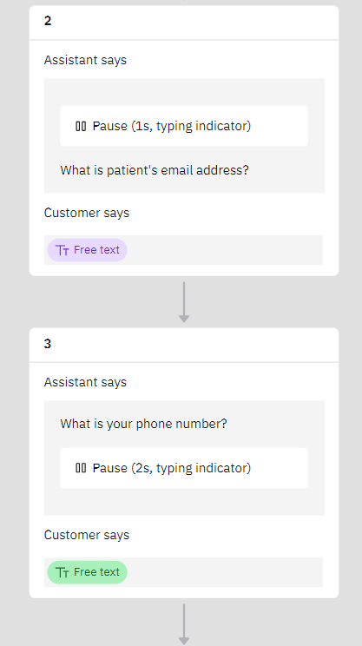
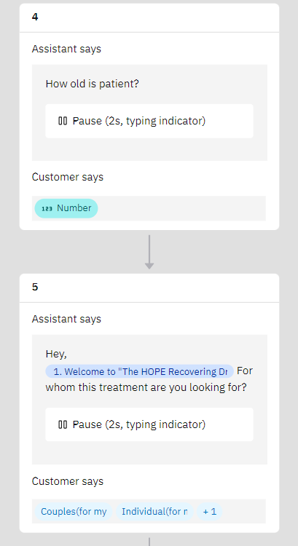
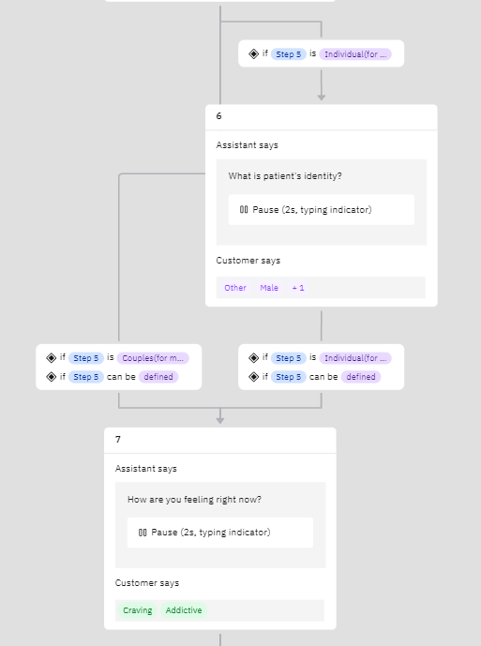
Algorithm & Deployment

Slide 7
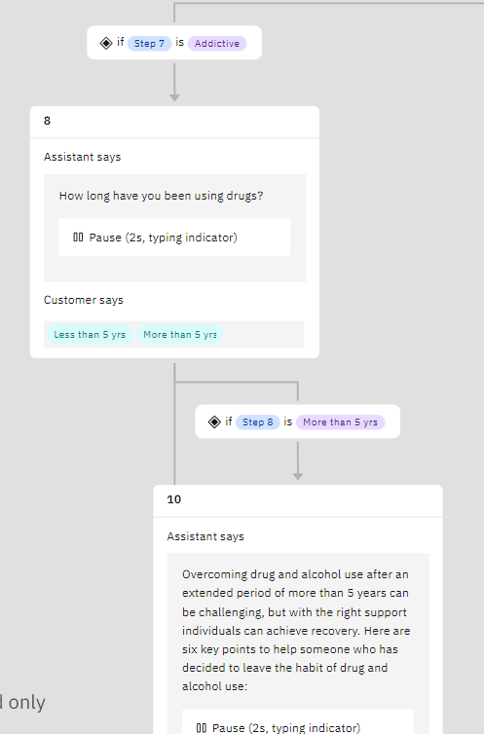
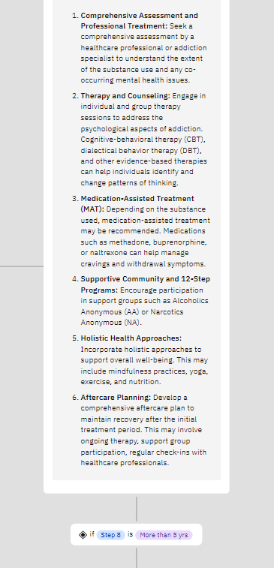
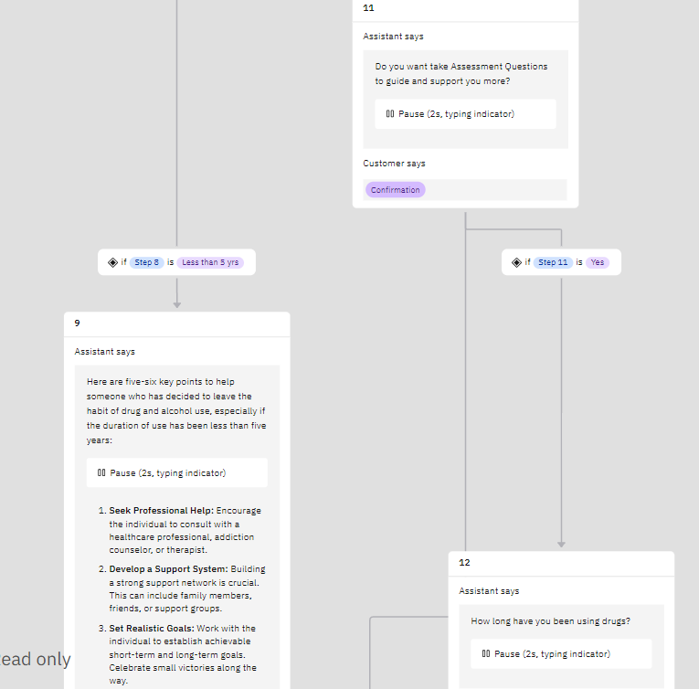
Algorithm & Deployment

Slide 8
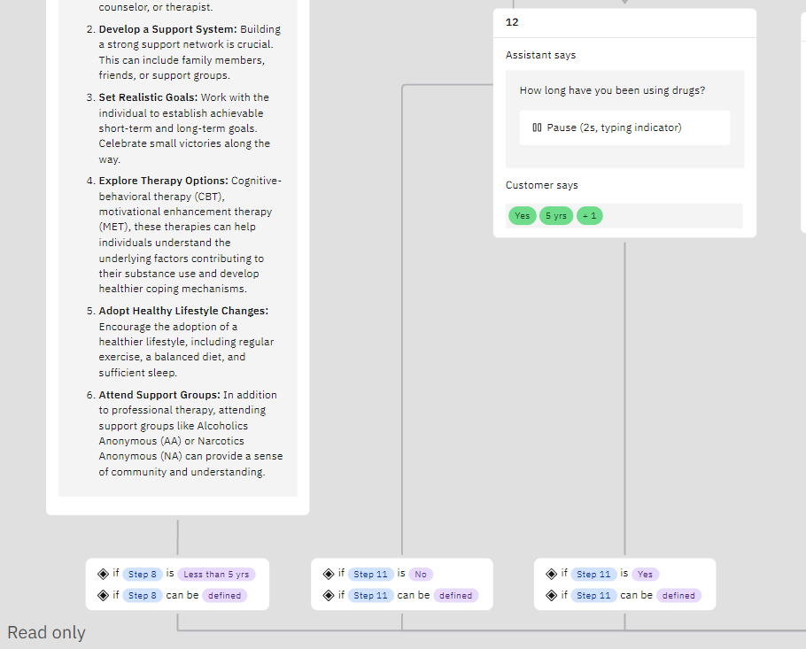
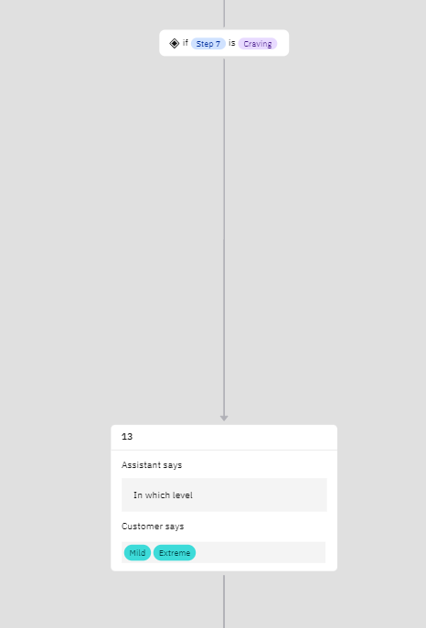
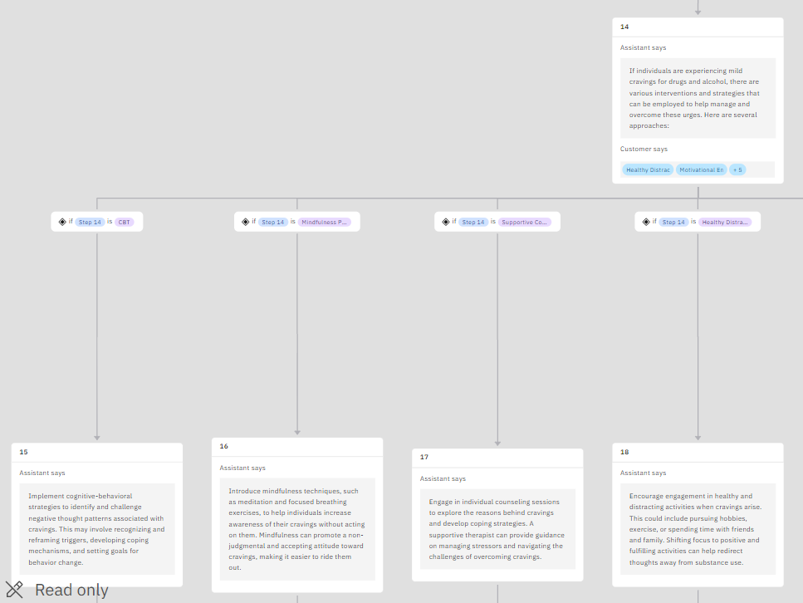
Algorithm & Deployment

Slide 9
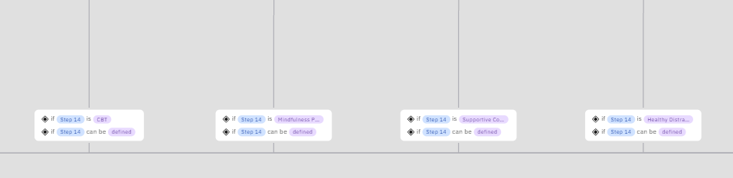
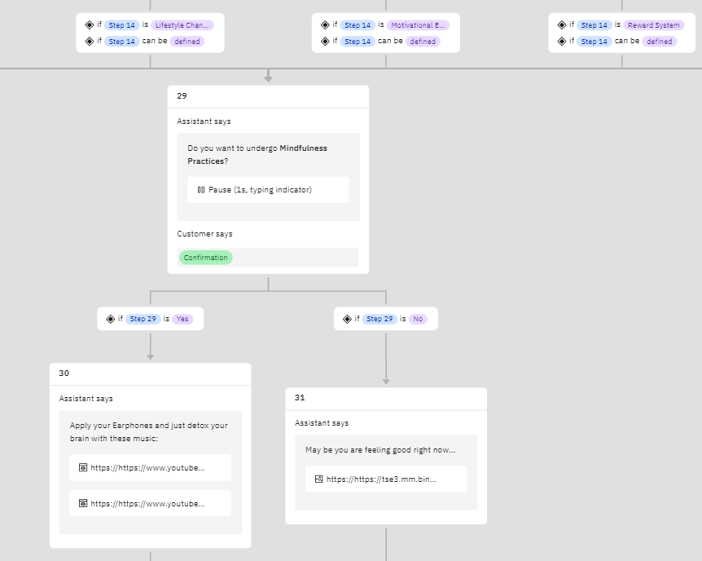
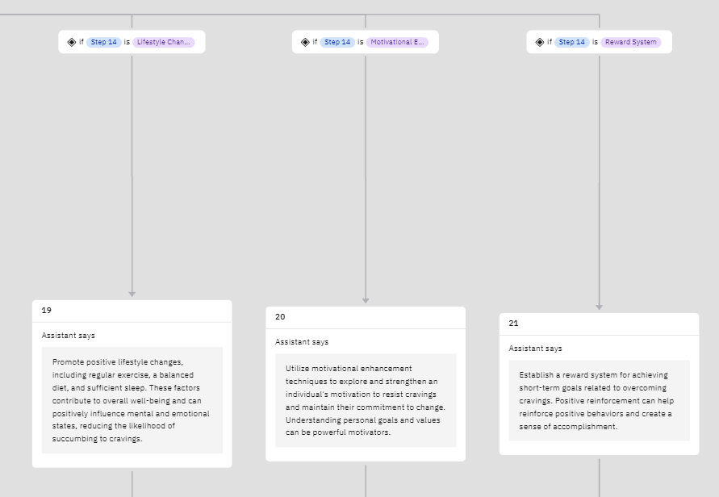
Algorithm & Deployment

Slide 10
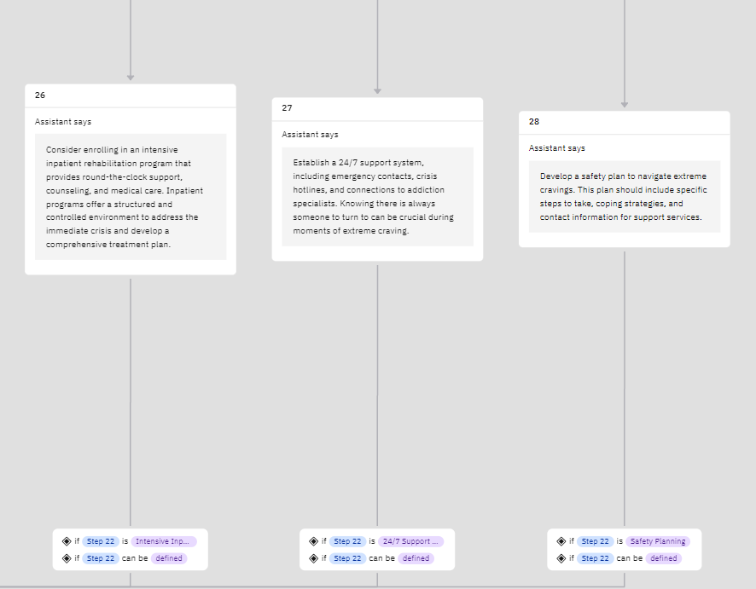
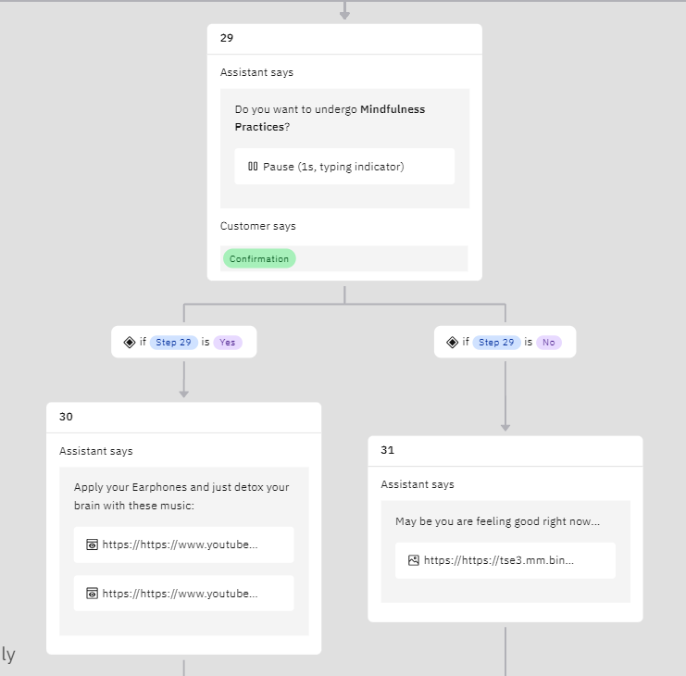
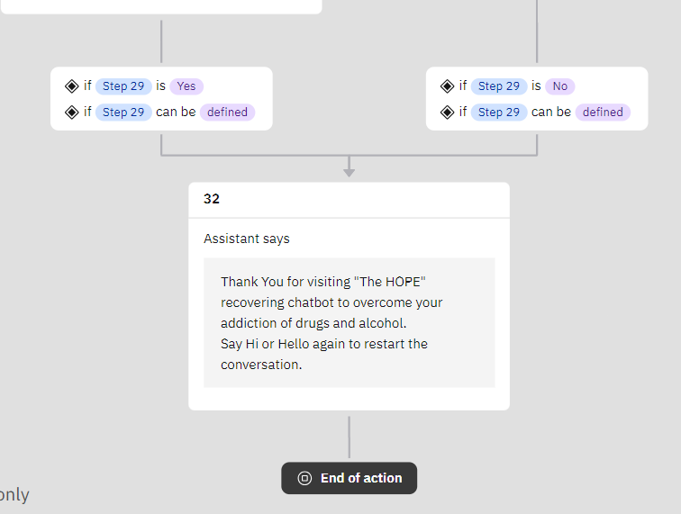
Algorithm & Deployment

Slide 11
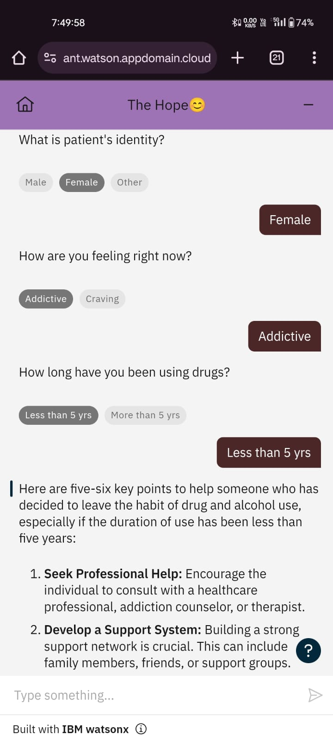
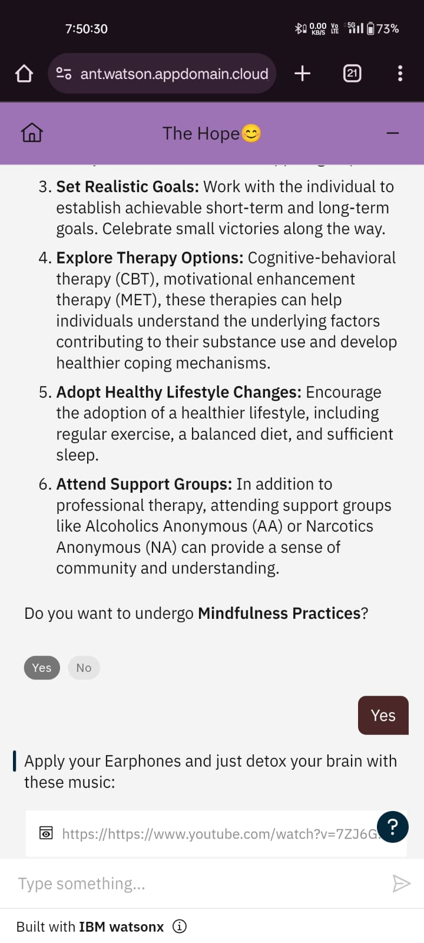
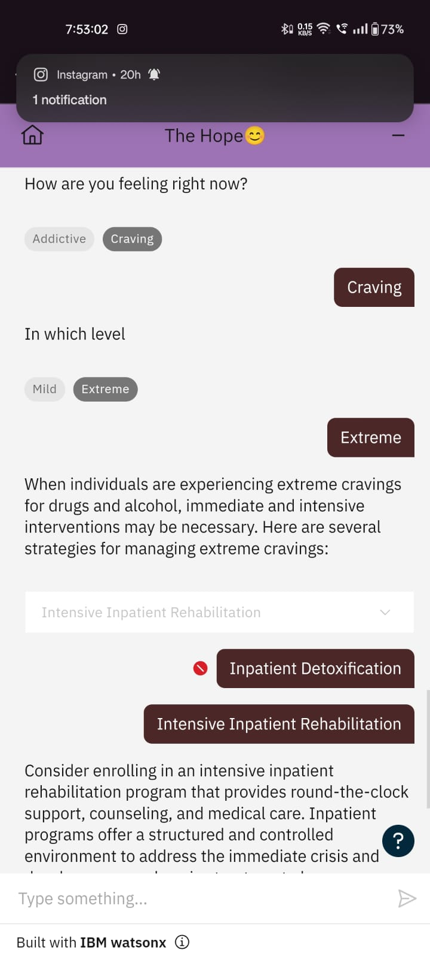
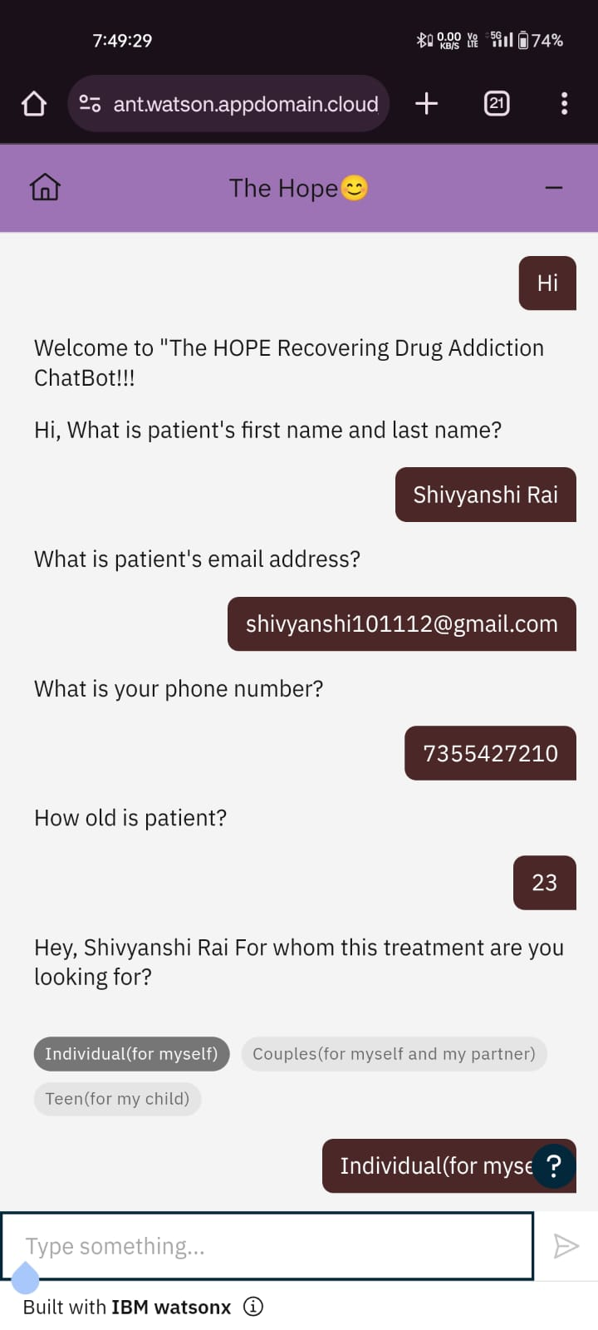
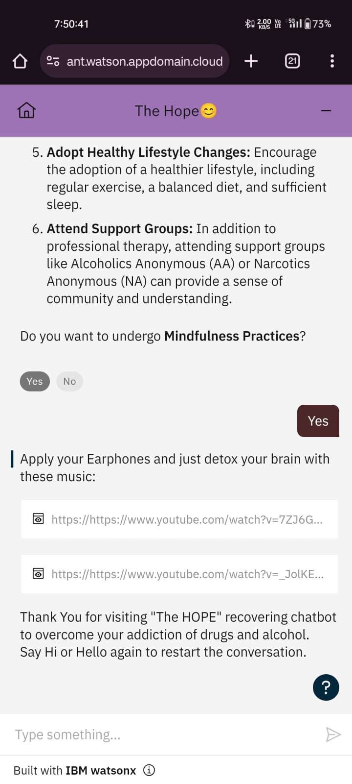
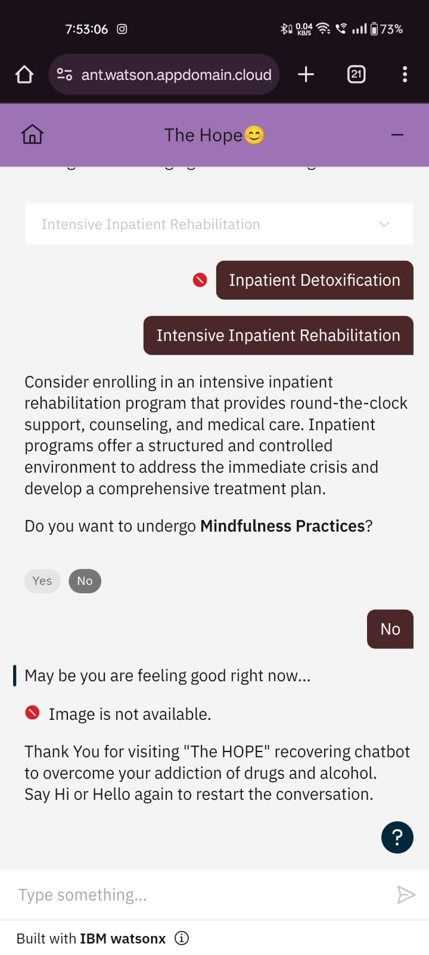
Result

Slide 12
Conclusion
In summary, The Hope Chatbot stands as a groundbreaking solution at the intersection of technology and healthcare, addressing the critical challenge of drug and alcohol addiction. With its user-centric design, incorporating features like personalized interventions and real-time support, The Hope Chatbot aims to revolutionize addiction support services. Privacy and security are paramount, recognizing the sensitivity of user information, while continuous improvement and collaboration with healthcare professionals ensure a dynamic and effective resource.
As it enters implementation, The Hope Chatbot has the potential to be a transformative force in complementing traditional support systems, offering personalized assistance and fostering a more compassionate and stigma-free approach to addiction recovery. Ultimately, this initiative reflects a commitment to empowering individuals and contributing to a healthier, more supportive society.

Slide 13
Future scope
Personalization and AI Advancements: Future iterations can leverage advancements in artificial intelligence (AI) to enhance personalization, providing even more tailored interventions based on user preferences, learning styles, and real-time progress.
Integration with Wearable Technology: Integration with wearable devices could enable the chatbot to gather real-time data on users' physiological and behavioral patterns, allowing for more accurate assessments and timely interventions.
Gamification for Engagement: Gamification elements could be introduced to enhance user engagement, making the recovery process more interactive and rewarding, while fostering a sense of accomplishment and progress.
Collaboration with Healthcare Professionals: Further collaboration with healthcare professionals, therapists, and addiction specialists can enhance the chatbot's efficacy, ensuring that it aligns seamlessly with traditional treatment plans and receives valuable input from experts.

Slide 14
References
https://www.tandfonline.com/doi/full/10.1080/17434440.2021.2013200
https://www.researchgate.net/publication/373116302_Chatbots_in_Drug_Discovery_A_Case_Study_on_Anti-Cocaine_Addiction_Drug_Development_with_ChatGPT
https://doi.org/10.1159/000525959
https://www.researchgate.net/publication/363147673_The_Use_of_Chatbots_as_Supportive_Agents_for_People_Seeking_Help_with_Substance_Use_Disorder_A_Systematic_Review
https://www.mobihealthnews.com/news/study-chatbots-could-help-people-substance-use-disorder-avoid-relapse

Slide 15
THANK YOU

